Slide 1
READ ME This template uses the font ‘Space Grotesk’ – be sure to download the font before making edits to the deck. Here’s the link to the ZIP file containing the font. If you cannot access the link above, you can download the font for free via Google Fonts.

Slide 2
Shell Scripting

Slide 3
Write PowerShell script

Slide 4
Convert to Bash shell script

Slide 5
Public API integration challenge

Slide 6
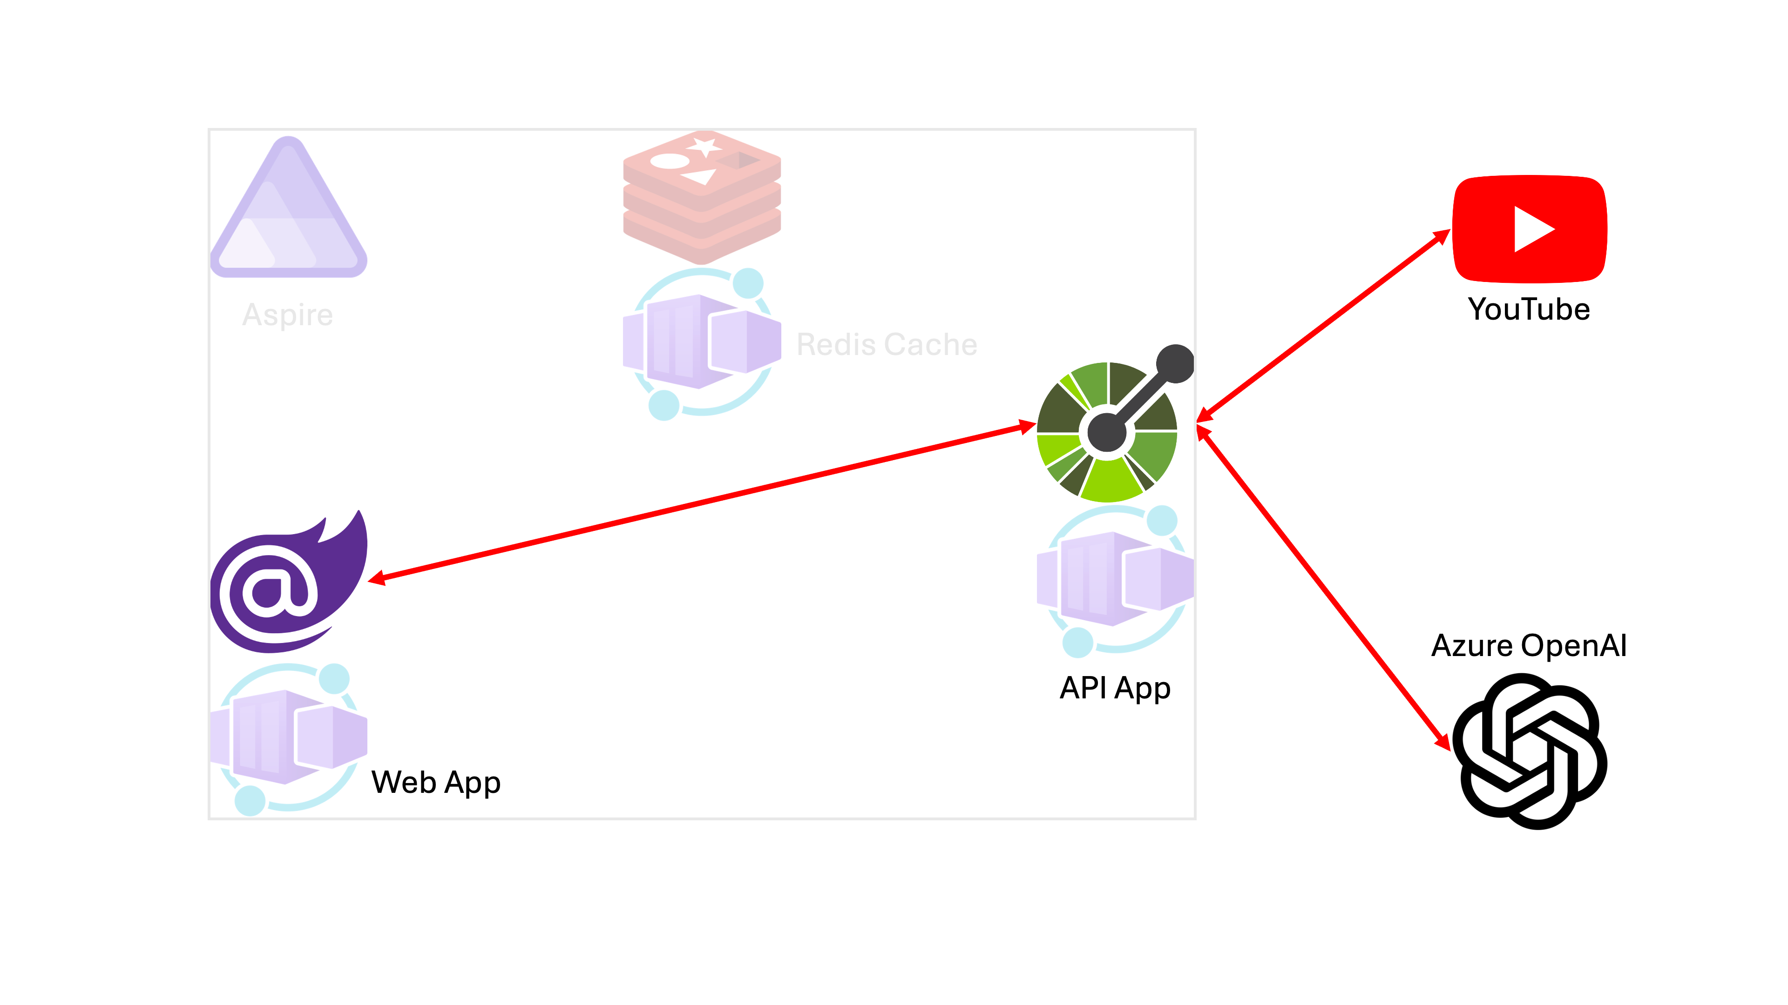

Slide 7
Let’s get started!
https://bit.ly/gh-copilot-lite

